Slide 1

Welcome to BrainPOP!

Slide 2
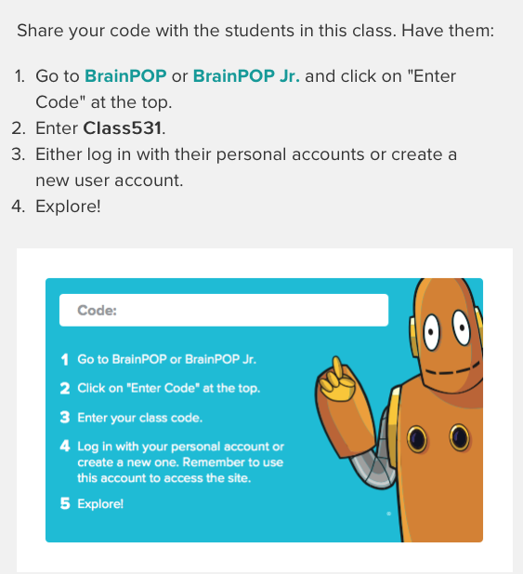

How to Sign On:
EVERYONE MUST INSERT:
Username: FIRSTNAME531
(Example: lana531)
Password: student531

Slide 3
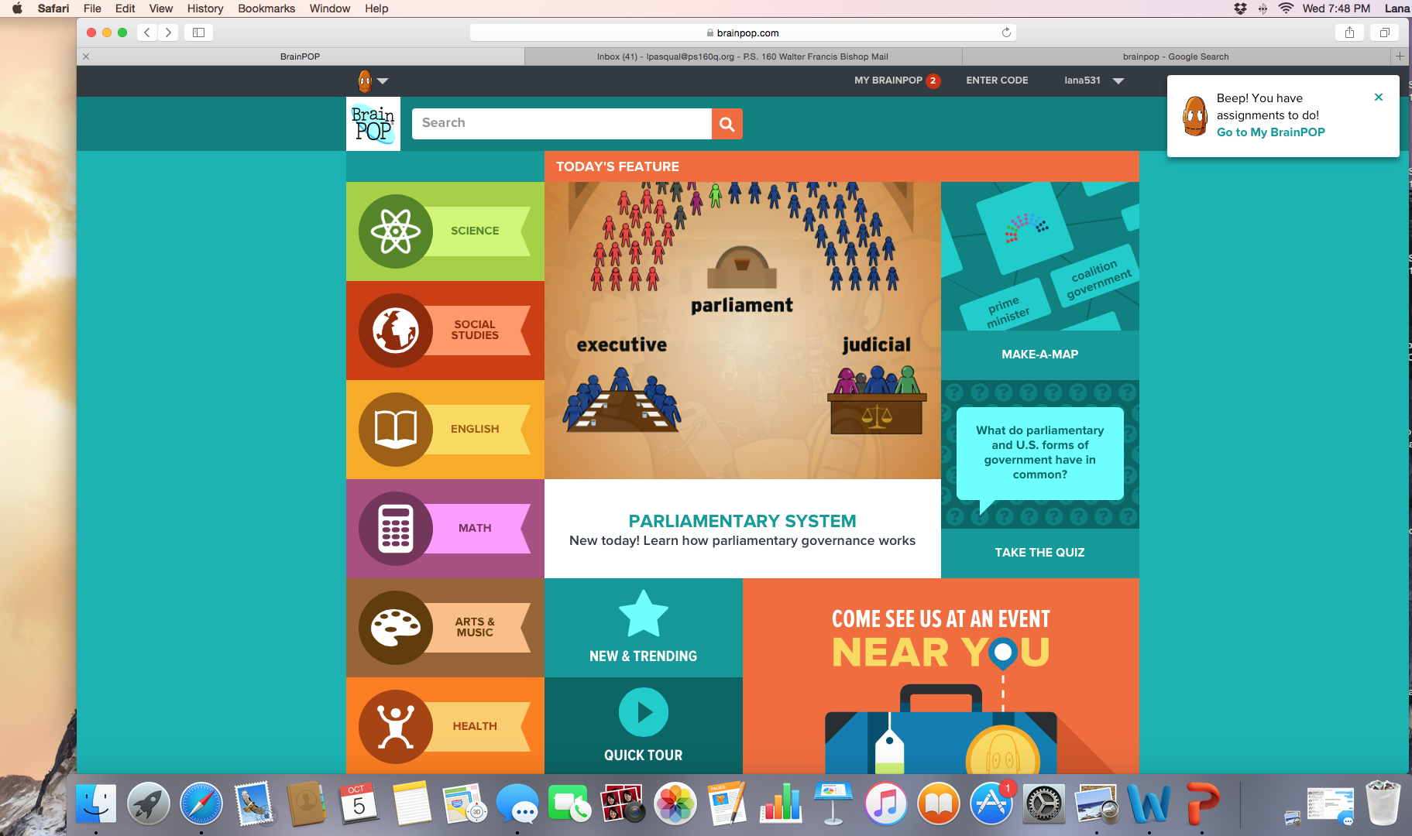
To find assignments:

Slide 4
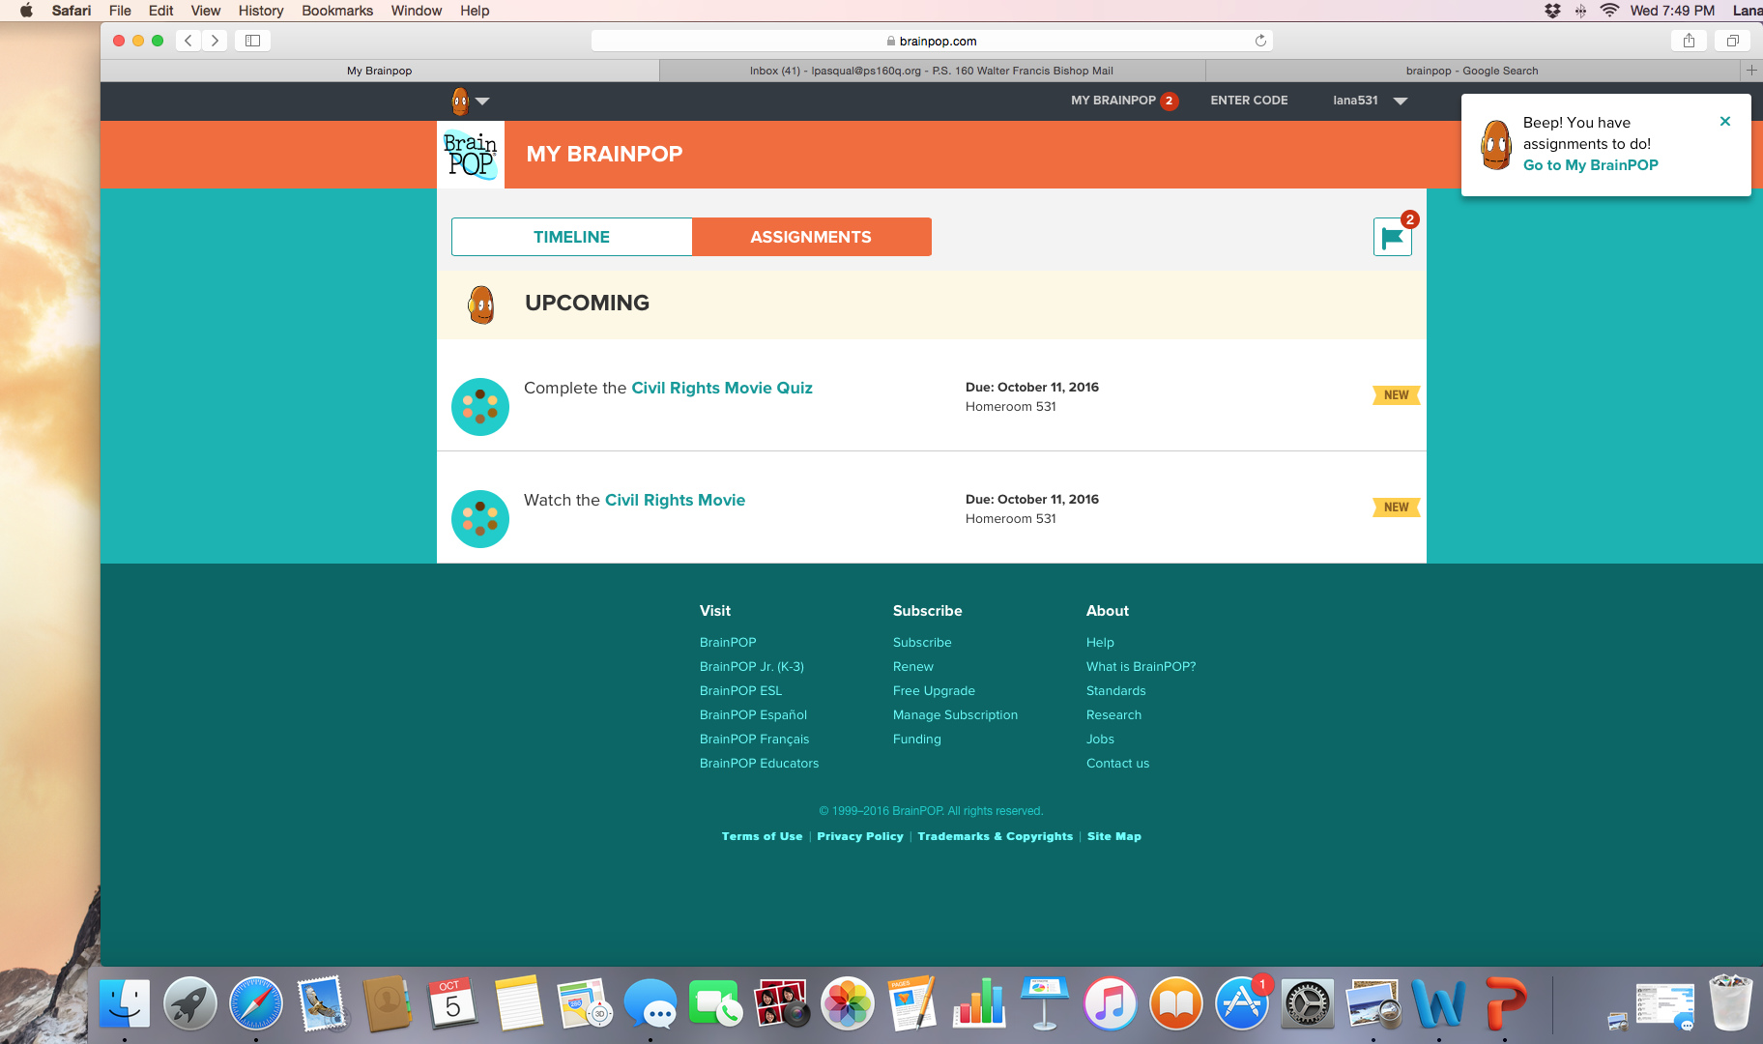
To see assignments and when they are due:

Slide 5
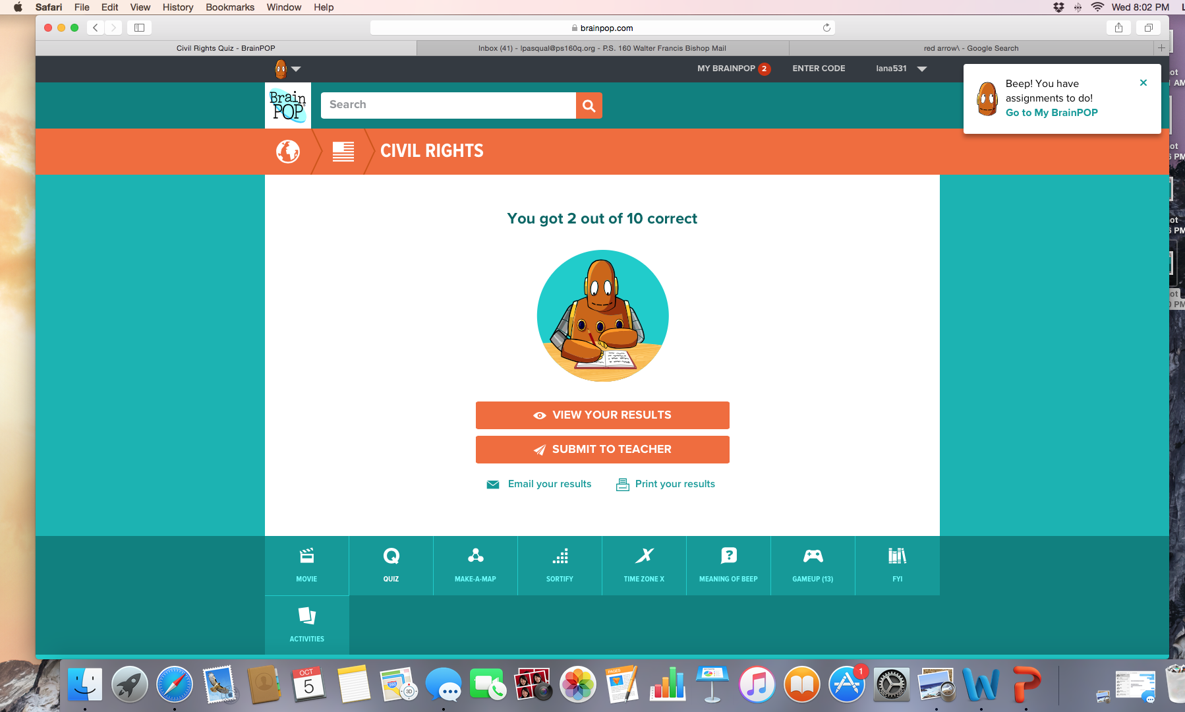
To submit your quiz and/or to see your results:

Slide 6
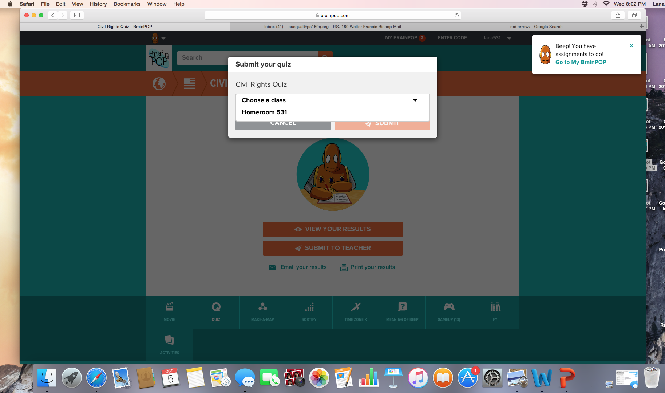
Choose your class and press submit:
PRESS SUBMIT

